Slide 1
Public transportation and optimization
Team members:
G.Swetha
P.Nandhini
S.Manjuladevi
A.Chinnathai
Guided by:
Mrs.S.Vaitheki
Assistant proffessor
Dept of ECE

Slide 2
objectives
By establishing a multi objective public transportation dispatching optimization model , starting from bus companies , passengers and govt department , public transportation operation costs comprehensively consider the interests of various parties and finally realize the optimization objective of minimizing fixed costs
We using the smart transportation system to optimizing the public transport

Slide 3
Using smart transportation
“Intelligent Transportation Systems (ITS) apply a variety of technologies to monitor, evaluate, and manage transportation systems to enhance efficiency and safety.” Putting visions of science fiction style transportation aside for the moment, this definition can be simplified into the following concepts for what makes up smart transportation: management, efficiency, and safety.

Slide 4
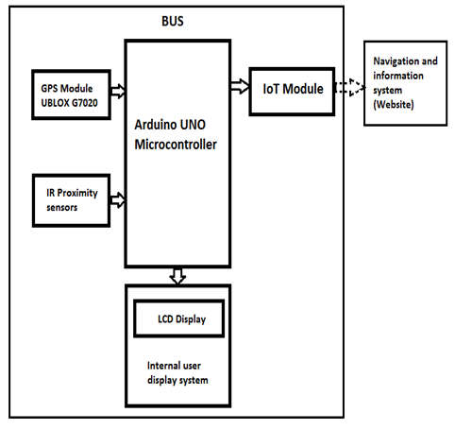
Block digram

Slide 5
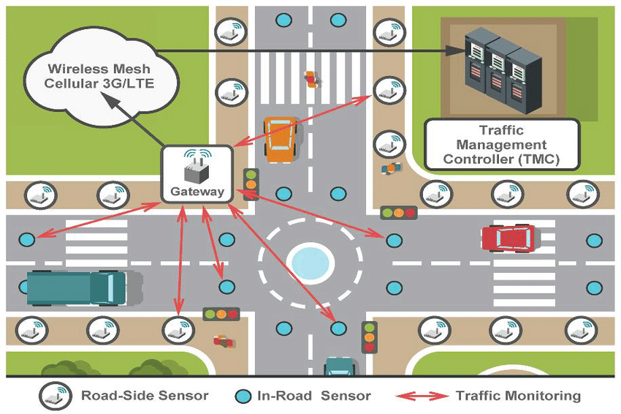
Using iot

Slide 6
Smart transportation
Introduction:
Smart transportation is not just a theory for the future; it is being implemented today in several cities with their successes and failures being used to improve systems in new locations. Some of the cities that are implementing new transportation technologies may surprise you at first. Of course, global hubs like New York City have embraced smart transportation for their ever increasingly intelligent city. However, the rural state of Wyoming is also a leading testbed for connected vehicles. This is because the cowboy state is a major freight corridor — autonomous transportation of goods across the country can drastically improve supply chain efficiency and reduce the need for long-haul drivers forced to balance tight timelines with their human need for rest.

Slide 7
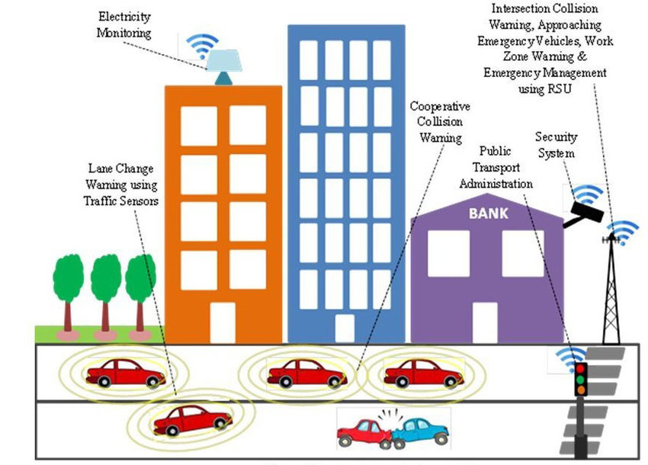
Using iot

Slide 8
Problem description
Punctuality is not maintained in public transport service and route rationalization
Does not optimize service distribution
Crowd in popular routes and also waiting time is extended
Hardware requirement:
Gps
Smart cars use allow a central center to monitor all operation
Software requirement:
Python used in machine learning

Slide 9
Python coding for traffic monitoring
global trafficLightNormalCurrState
state = emergencyVehicleState["state"]
if state == NORMAL:
if (LIGHT_RED == trafficLightNormalCurrState):
print "Switching to RED\n"
set_red()
elif (LIGHT_YELLOW == trafficLightNormalCurrState):
def updateTrafficSignal():
print "Switching to YELLOW\n"
set_yellow()
elif (LIGHT_GREEN == trafficLightNormalCurrState):
print "Switching to GREEN\n"
set_green()
time.sleep(trafficLightNormalCycleTime[trafficLightNormalCurrState])
trafficLightNormalCurrState = trafficLightNormalCycle[ (trafficLightNormalCurrState + 1) % 3]
elif state == CRITICAL:
set_green()
print "Detected Critical Distance from Emergency Vehicle\n"
print "Switching to GREEN and Hold\n"
time.sleep(3)

Slide 10
Traffic signal monitoring in emergency time:
handleEmergencyMessage calculates the distance between the traffic signal and the vehicle and updates the state. The state can be either NORMAL(0) or CRITICAL(1), meaning that the emergency vehicle is in close proximity to the signal intersection.
Based on the current state, the function updateTrafficSignal gets invoked periodically and takes the appropriate action. For the NORMAL case, it just toggles through the normal sequence of red, amber and green lights. For the CRITICAL state, it holds on to the green light to allow the passage of the emergency vehicle.

